Slide 1

Instruction Sets: Characteristics and Functions
Diadaptasi dari
Chapter 10
William Stallings Computer Organization and Architecture 8th Edition

Slide 2
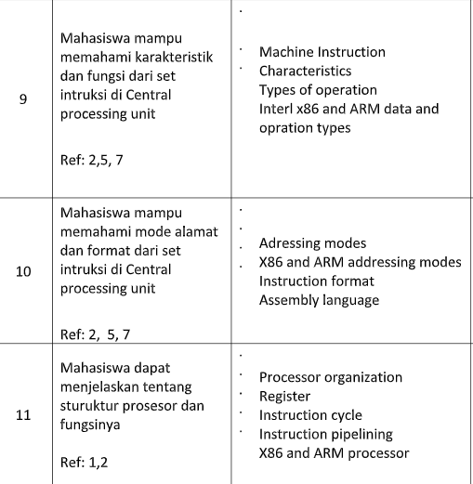
Pertemuan Setelah UTS

Slide 3
Overview Pertemuan Ini
Instruction Set
Pengertian
Komponen
Representasi
Jenis instruksi
Jumlah Alamat pada instruksi
Design Decision
Jenis operand
Data types

Slide 4
Machine Instuction Characteristics?
Operasi dari sebuah prosesor ditentukan oleh instruksi-instruksi yang dikerjakan oleh prosesor tersebut, yang sering disebut dengan machine instruction, atau computer instruction
Kumpulan dari semua instruksi yang bisa dipahami dan dieksekusi oleh prosesor disebut instruction set
Machine Code
Binary
Usually represented by assembly codes
Notes:
2

Slide 5
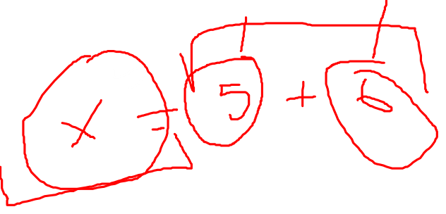
Elements of an Instruction
Operation code (Op code)
Do this: Menjelaskan operasi apa yang harus dikerjakan (ADD,I/O)
Source Operand reference
Instruksi bisa melibatkan 1 atau lebih operand sebagai input dari operasi
Result Operand reference
Put the answer here
Next Instruction Reference
Setelah instruksi ini selesai, dimana alamat instruksi selanjutnya
Masing-masing instruction harus terdiri dari elemen yang dibutuhkan oleh prosesor untuk eksekusi instruksi tersebut.
Notes:
3

Slide 6
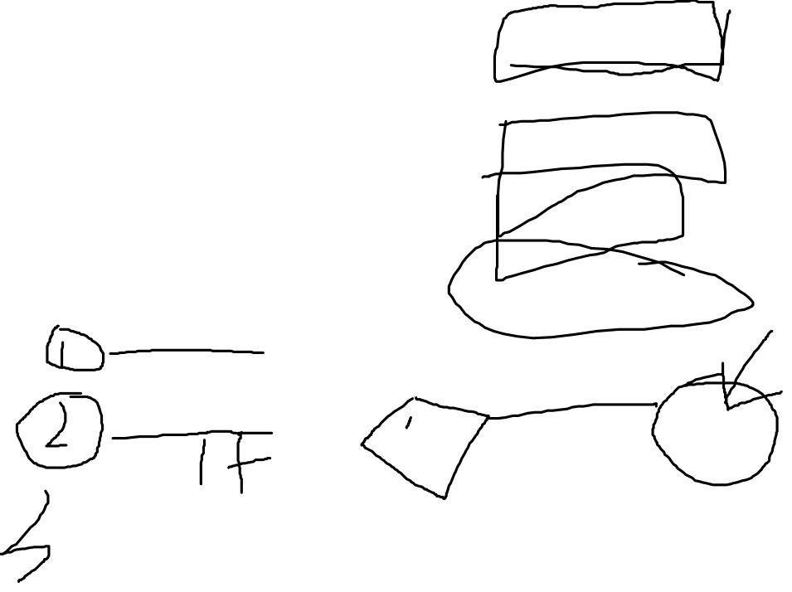
Dimanakah Source dan Result operand?
Main memory (or virtual memory or cache)
CPU register
Immediate
I/O device
Notes:
4

Slide 7
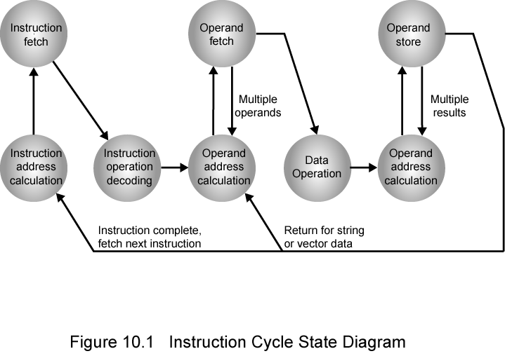
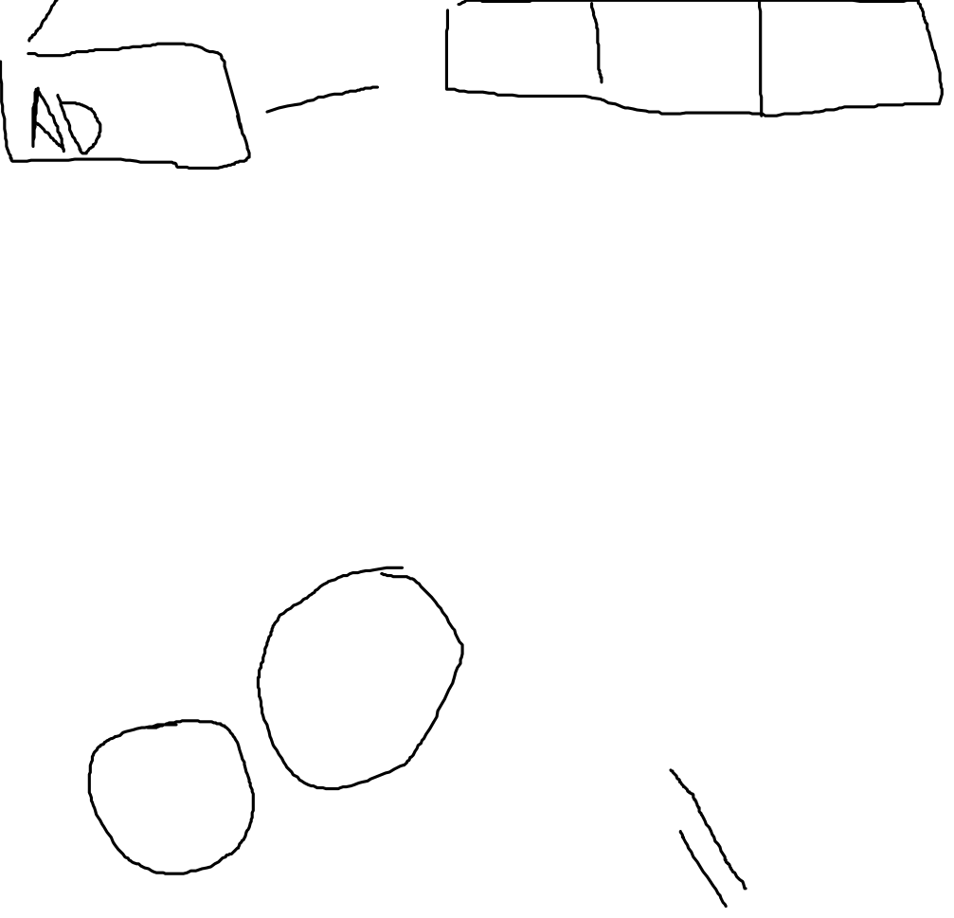
Instruction Cycle State Diagram

Slide 8
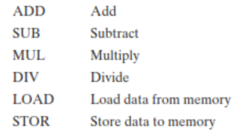
Instruction Representation
In machine code each instruction has a unique bit pattern
For human consumption (well, programmers anyway) a symbolic representation is used
e.g. ADD, SUB, LOAD
mnemonics
Operands can also be represented in this way
ADD A,B
Bagaimana instruksi direpresentasikan
Notes:
5

Slide 9
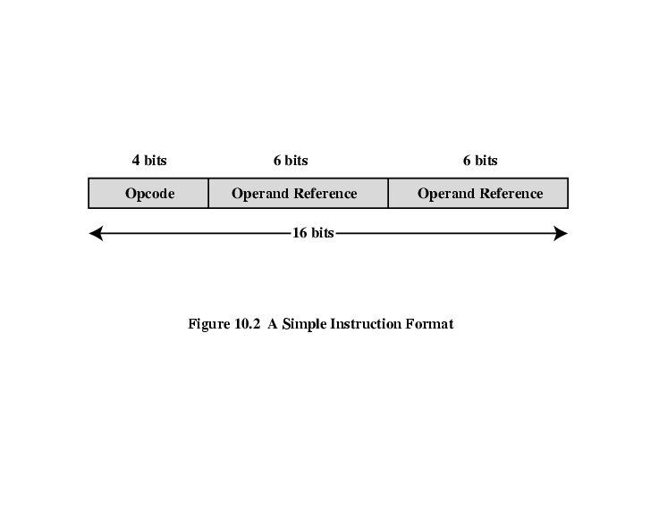
Simple Instruction Format

Slide 10
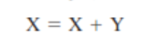
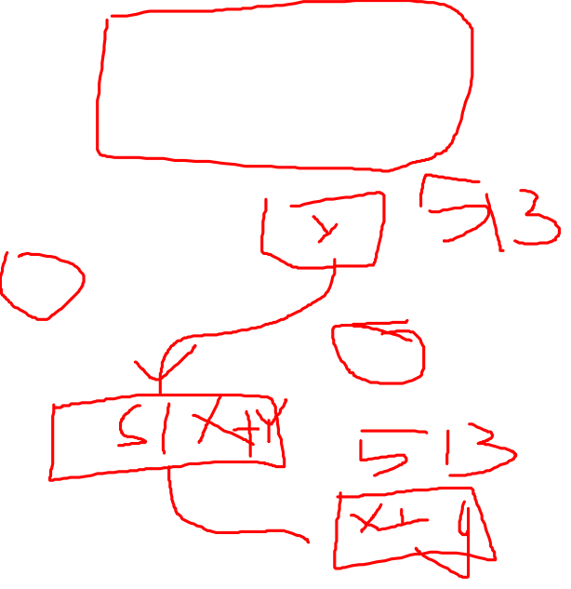
Contoh Operasi Sederhana
Satu baris code pada high level language diterjemahkan dalam machine language sebagai berikut:
Load a register with the contents of memory location 513.
Add the contents of memory location 514 to the register.
Store the contents of the register in memory location 513.
A high- level language expresses operations in a concise algebraic form,using variables.
A machine language expresses operations in a basic form involving the movement of data to or from registers
X ada di alamat memori 513
Y ada di alamat memori 514

Slide 11
Instruction Types
Data processing
Arithmetic and logic instructions
Data storage (main memory)
Movement of data into or out of register and or memory locations.
Data movement (I/O)
I/O instructions
Program flow control
Test and branch instructions
A computer should have a set of instructions that allows the user to formulate any data processing task
Notes:
6

Slide 12
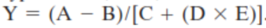
Jumlah alamat pada instruksi
Alamat yang dibutuhkan untuk operasi aritmatika
2 operand
1 alamat hasil
1 alamat instruksi selanjutnya
Most architecture: instructions have one, two, or three operand addresses, with the address of the next instruction being implicit (obtained from the program counter)

Slide 13
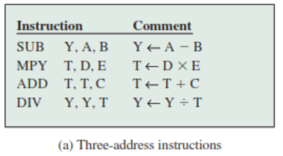
Number of Addresses (a)
3 addresses
Operand 1, Operand 2, Result
a = b + c;
May be a forth - next instruction (usually implicit)
Not common
Needs very long words to hold everything
Notes:
7

Slide 14
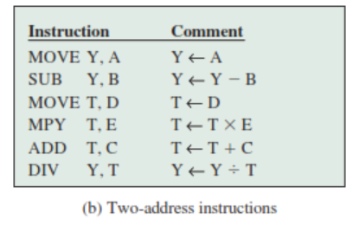
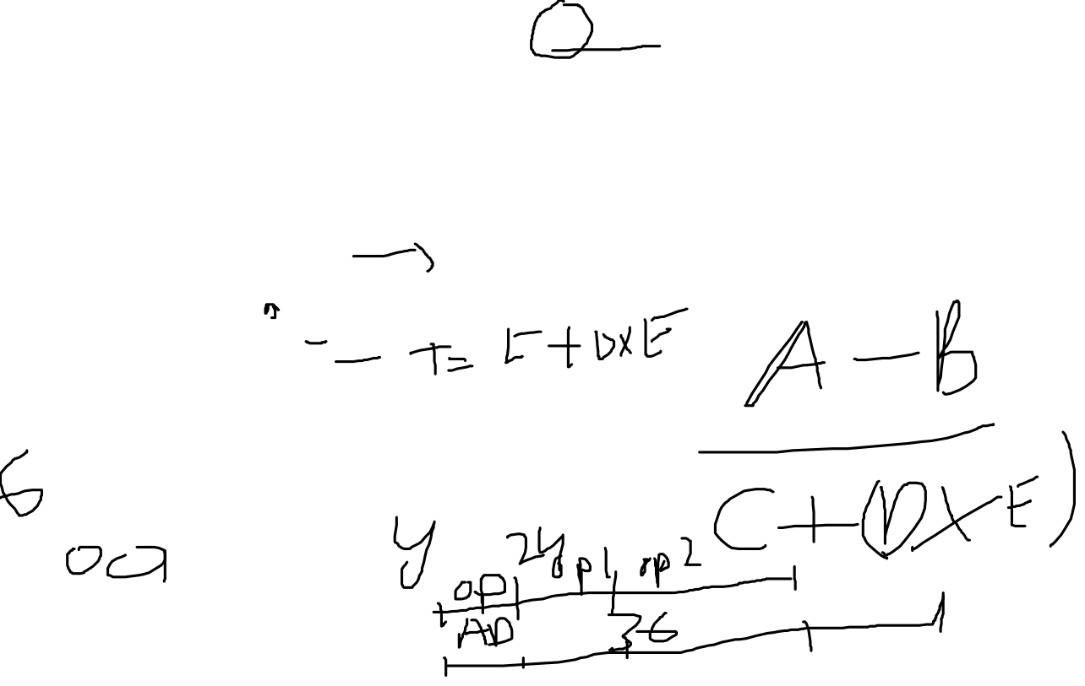
Number of Addresses (b)
2 addresses
One address doubles as operand and result
a = a + b
Reduces length of instruction
Requires some extra work
Temporary storage to hold some results
Notes:
8

Slide 15
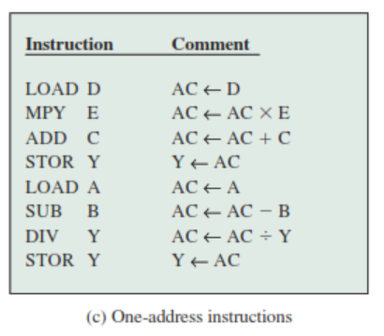
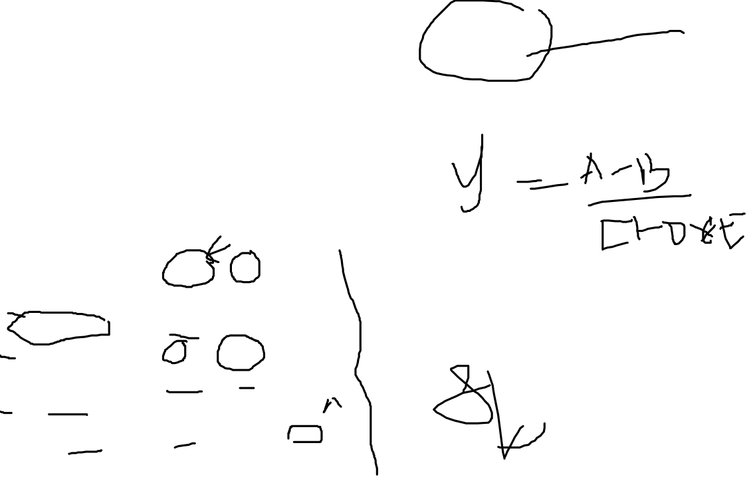
Number of Addresses (c)
1 address
Implicit second address
Usually a register (accumulator)
Common on early machines
Notes:
9

Slide 16
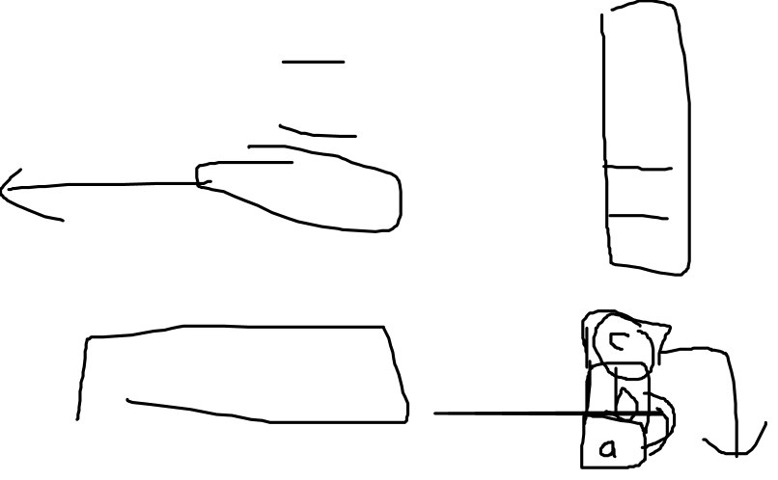
Number of Addresses (d)
0 (zero) addresses
All addresses implicit
Uses a stack
e.g. push a
push b
add
pop c
c = a + b
Notes:
10

Slide 17
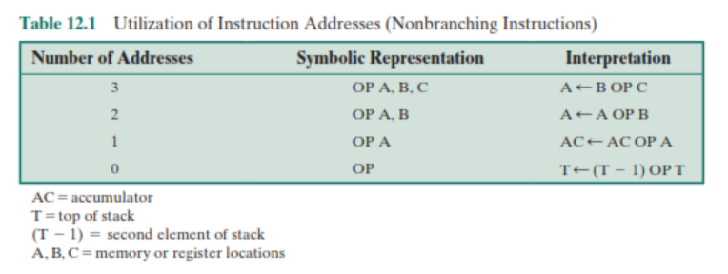

How Many Addresses
More addresses
More complex (powerful?) instructions
More registers
Inter-register operations are quicker
Fewer instructions per program
Fewer addresses
Less complex (powerful?) instructions
More instructions per program
Faster fetch/execution of instructions
Notes:
11

Slide 18
Instruction Set Design Decisions (1)
Operation repertoire
How many ops?
What can they do?
How complex are they?
Data types
The various types of data upon which operations are performed
Instruction formats
Length of op code field
Number of addresses
Notes:
12
The design of an instruction set is very complex because it affects so many aspects of the computer system.
The instruction set defines many of the functions performed by the processor and thus has a significant effect on the implementation of the processor. The instruction set is the programmer’s means of controlling the processor.
Thus, programmer requirements must be considered in designing the instruction set.

Slide 19
Design Decisions (2)
Registers
Number of CPU registers available
Which operations can be performed on which registers?
Addressing modes (later….)
Notes:
13

Slide 20
Jadi di pertemuan ini
Apa itu instruction set
Design Decision dalam pembuatan instruction set

Slide 21
Pertemuan Selanjutnya
Design decision:
Jenis operand
Jenis operasi

Slide 22
Pertanyaan
What are the typical elements of a machine instruction?
What types of locations can hold source and destination operands?
If an instruction contains four addresses, what might be the purpose of each address
List and briefly explain five important instruction set design issues.

Slide 23
